Slide 1
Python programming
unit 1b – is operator

Slide 2
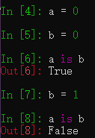
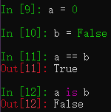
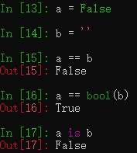
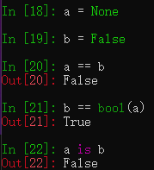
Check the result of those code

Slide 3
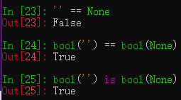
Facts in python
‘is’ is stronger than ‘==’
‘is’ means two things are actually same thing. Thus they must also be ‘==’
‘==’ not necessarily means the two things are same. It only mean the two value evaluated to be equal
Data value ‘None’ is a value which is not equal to 0, not equal to False, not equal to ‘’
Data value 0 is equal to False. But they are different value, so ‘is’ operator will return False
Bool conversion of empty string ‘’ and None, will return a new ‘False’ value

Slide 4
Facts in python
Similarly, value ‘True’ and value 1 is equal. True == 1.
But value ‘True’ is not same as 1.
Other non-zero value is not equal to ‘True’. Only bool conversion will be ‘True’
Similarly for non-empty string.

Slide 5
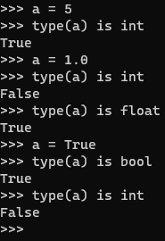
Use is to check type
Can use is operator to check type (this is to check the exact type)

